Slide 1

Basics of Everything
Sameer zulfi

Slide 2
Watch this Video
How a packet moves through network - YouTube

Slide 3
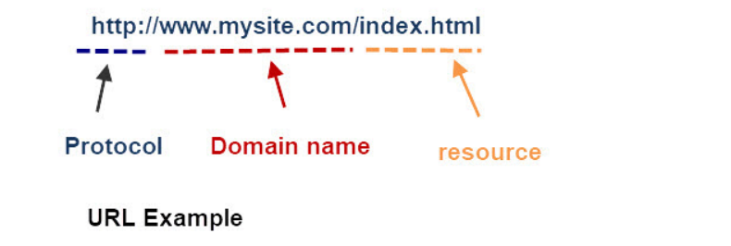
HTTP
Hyper Text Transfer Protocol
Why we are using ? This is used to transfer data across the internet

Slide 4
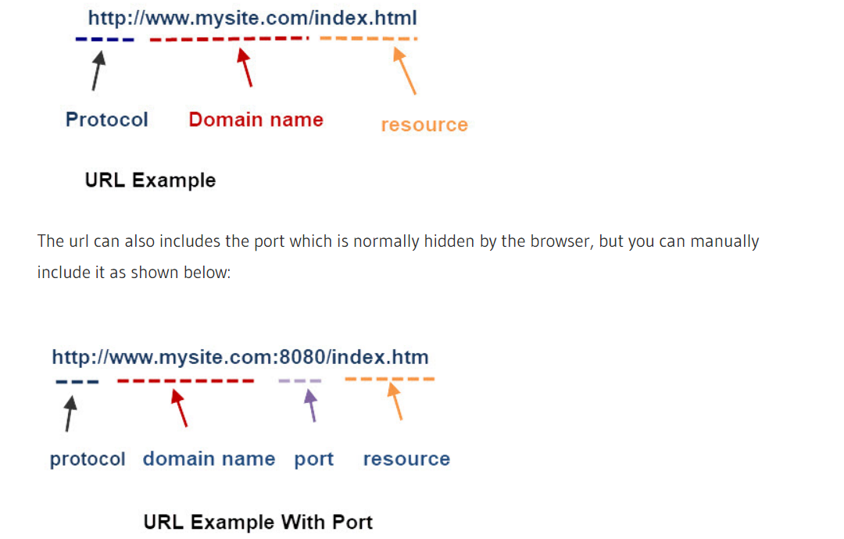

Slide 5
HTTP Responses & Response Codes
Each request has a response. The Response consists of a
STATUS code And Description
1 or more optional headers
Optional Body message can be many lines including binary data
Response Status codes are split into 5 groups each group has a meaning and a three digit code.
1xx – Informational
2xx – Successful
3xx -Multiple Choice
4xx– Client Error
5xx -Server Error
For example a successful page request will return a 200 response code and an unsuccessful a 400 response code.

Slide 6
Request Types, Methods or Verbs
The HTTP protocol now support 8 request types, also called methods or verbs in the documentation,they are:
GET – Requesting resource from server
POST – submitting a resource to a server (e.g. file uploads)
PUT -As POST but replaces a resource
DELETE-Delete a resource from a server
HEAD – As GET but only return headers and not content
OPTIONS -Get the options for the resource
PATCH -Apply modifications to a resource
TRACE -Performs message loop-back
On the Internet today the GET (getting web pages) and POST (submitting web forms)methods are the ones most commonly used.
The Other methods are used when working with Web and IOT APIs specifically put,delete and head.

Slide 7
TCP/IP Ports and Sockets Explained
On a TCP/IP network every device must have an IP address.
The IP address identifies the device e.g. computer.
Just as the IP address identifies the computer, The network port identifies the application or service running on the computer.
The use of ports allow computers/devices to run multiple services/applications.

Slide 8
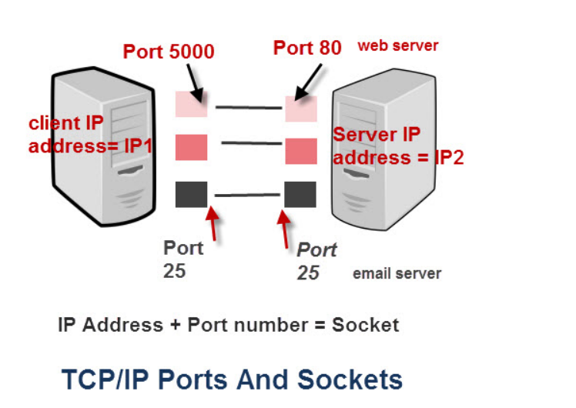
Ports

Slide 9
Example
If you use a house or apartment block analogy the IP address corresponds to the street address.
All of the apartments share the same street address.
However each apartment also has an apartment number which corresponds to the Port number.

Slide 10
TCP Sockets
A connection between two computers uses a socket.
A sockets is the combination of IP address plus port
Imagine sitting on your PC at home, and you have two browser windows open.
One looking at the Google website, and the other at the Yahoo website.
The connection to Google would be:
Your PC – IP1+port 60200 ——– Google IP2 +port 80 (standard port)
The combination IP1+60200 = the socket on the client computer and IP2 + port 80 = destination socket on the Google server.
The connection to Yahoo would be:
your PC – IP1+port 60401 ——–Yahoo IP3 +port 80 (standard port)
The combination IP1+60401 = the socket on the client computer and IP3 + port 80 = destination socket on the Yahoo server.
Notes: IP1 is the IP address of your PC. Client port numbers are dynamically assigned, and can be reused once the session is closed.

Slide 11
TCP and UDP – The Transport Layer
IP addresses are implemented at the networking layer which is the IP layer.
Ports are implemented at the transport layer as part of the TCP or UDP header as shown in the schematic below:
The TCP/IP protocol supports two types of port- TCP Port and UDP Port.
TCP – is for connection orientated applications. It has built in error checking and will re transmit missing packets.
UDP – is for connection less applications. It has no has built in error checking and will not re transmit missing packets.

Slide 12
Applications are designed to use either the UDP or TCP transport layer protocol depending on the type of connection they require.
For example a web server normally uses TCP port 80.
It can use any port, but the web server application is designed to use a TCP connection
Please see this video in future : https://youtu.be/r59LJARW8hU

Slide 13
Checking for Open Ports
Windows and Linux systems have a utility called netstat which will give you a list of open ports on your computer.
Please check this video - https://youtu.be/935g6vWcLfU

Slide 14
TCP/IP Model and Protocol Suite Explained
What is a Protocol ?
A protocol is a set of rules that govern how systems communicate. For networking they govern how data is transferred from one system to another.
What is a Protocol Suite ?
A protocol suite is a collection of protocols that are designed to work together.
Before TCP/IP became the de-facto standard other protocol suites like IPX and SPX were common (Novell).

Slide 15
It is possible to write a single protocol that takes data from one computer application and sends it to an application on another computer.- A Single stack Protocol
The problem with this approach is that it very inflexible, as any changes require changing the entire application and protocol software.
The approach used in networking is to create layered protocol stacks.
Each level of the stack performs a particular function and communicates with the levels above and below it.

Slide 16
Example
Lets take an example of a parcel service between two offices.
The task is simple – send parcels between people in each office.
We will divide the task into two distinct processes as follows:
Take a package, wrap it and address it.
Send it to the destination
at the receiving end
Receive the package
Deliver it to the recipient

Slide 17
Example Continuation
Typically you would have an internal mail man that:
Collects the parcels from the senders and takes then to a mail dispatch room.
The parcels are placed in a van by the dispatcher and then driven to the remote office.
At the remote office
The parcels are received by the dispatcher and placed into a tray for the mail man
The mail man collects the parcels and delivers them to the recipients,

Slide 18
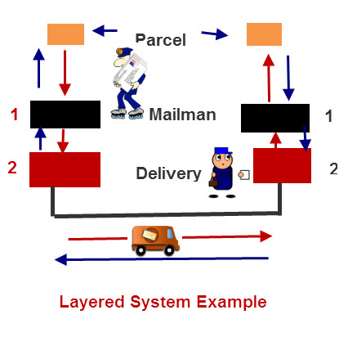
Why this layered approach ?
The question really is what is the advantage of splitting the task into different layers/tasks?
The answer is that any of the layers/tasks can be changed without affecting the other layers.
So if for example, if we decide to use a train instead of a van to transport the messages
between the offices we could do so without affecting the mail man.
In fact the mail man doesn’t know, and doesn’t care, how the parcels are
transported between the offices, as all he does is collect them, and pass them to the delivery man.

Slide 19
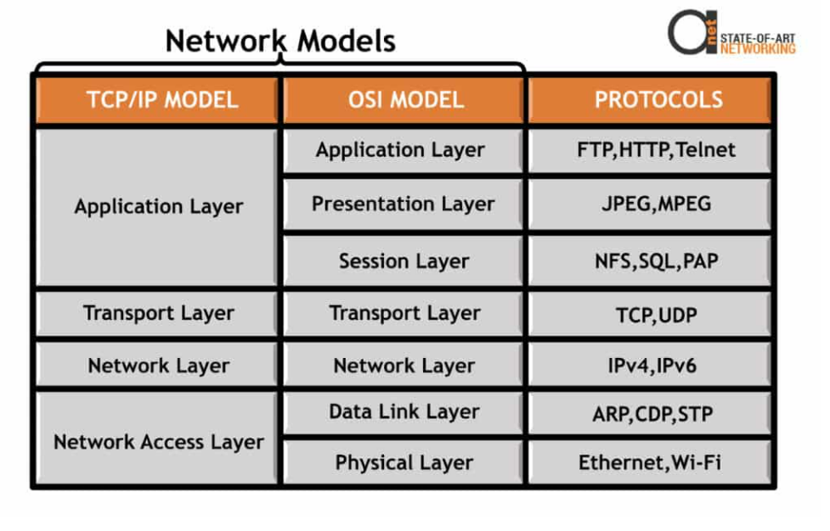
Network Models

Slide 20
TCP vs UDP – what’s the difference ?
Both TCP and UDP sit at the transport layer of the TCP/IP protocol stack and both use the IP protocol.
TCP – Transmission Control Protocol.
TCP is a connection orientated protocol with built in error recovery and re transmission.
You can liken a TCP connection to a telephone connection.
With a telephone connection you first need to setup the connection by dialing the number, and once the calling party answers you have a both way communications channel.
You then proceed to speak and once done you hang up the connection.
TCP is used by application protocols that need guaranteed message delivery.
HTTP,FTP, SMTP, POP3, IMAP4 and many other common Internet application protocols use TCP.

Slide 21
TCP vs UDP continuation
UDP – User Datagram Protocol
UDP is a connectionless protocol.
You can liken UDP to email or the normal post.
With email or a written message you send your message, but have no idea whether or not that message was received.
UDP does not correct or recover errors in the message. Any error detection and recovery is the responsibility of the receiving application.
Because there is no connection setup, UDP is faster than TCP and results in less network traffic.
In addition it doesn’t consume resources on the receiving machine as it doesn’t hold a connection open.
Utility applications like DNS, DHCP, RIP and others use UDP.

Slide 22
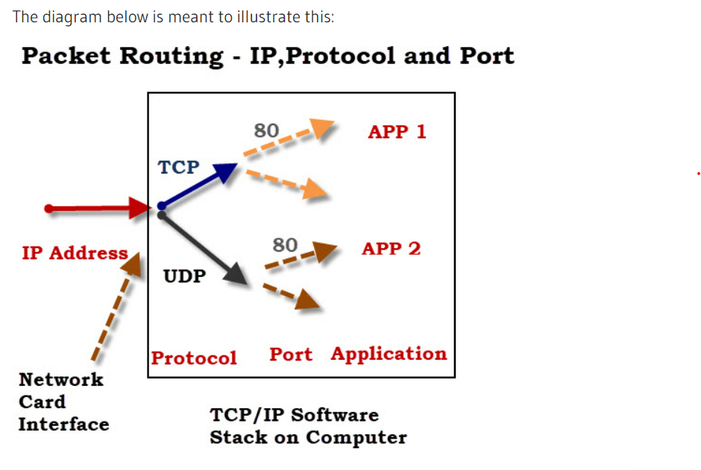
TCP vs UDP Ports
Both TCP and UDP protocols use ports. You can have an application running on a computer using TCP port 80 and another application using UDP port 80.
An application address is effectively:
IP address + protocol (TCP or UDP) + port number.

Slide 23
Questions
Q- Can I change what protocol my application uses?
A- No the choice of transport protocol is done by the application developer.
Q- Are TCP ports different than UDP ports?
A- Yes a machine can be communicating on UDP port 2000 and TCP port 2000 at the same time.
Q- What is an ephemeral port?
A- It is a port that is only used for short period. An ephemeral port is typically used by a client when it connects to a server. The range is usually 49152 through 65535

Slide 24
What are Ports and Protocols ?
- Protocols means set of rules
- In IT Industry, Protocol means standard way for computers to exchange information.
- Most common protocols are TCP – Transmission Control Protocol, UDP – User Datagram Protocol, IP – Internet Protocol
- Data on the Internet is organized into Standard TCP or UDP Packets.
- Generally One Port is used to send data and another to receive it, so that packets won’t collide/jammed
- Ports range from 1 to 65535 for the TCP and UDP Protocols

Slide 25
Ports and Protocols
Port numbers are generally divided into three ranges: 1. The Well Known ports: 0 to 1023 These are allocated to server services by the Internet Assigned Numbers Authority (IANA). e.g Web servers normally use port 80 and SMTP servers use port 25 2. The Registered ports: 1024 to 49151 These can be registered for services with the IANA and should be treated as semi-reserved. User written programs should not use these ports. 3. The Dynamic and/or Private ports: 49152 to 65535 These are used by client programs and you are free to use these in client programs. When a Web browser connects to a web server the browser will allocate itself a port in this range. Also known as ephemeral ports.
Look for IANA port #

Slide 26
TCP/IP and OSI Network Models
OSI – Open System Interconnection – 7 Layer model which defines how information is moving between networked computers.
It describes how information flows from one end-user application through a network into another application

Slide 27
Most Common TCP/IP Protocols
TCP:
Transmission Control Protocol is an internet protocol suite which breaks up the message into TCP Segments and reassembling them at the receiving side.
IP:
An Internet Protocol address that is also known as an IP address is a numerical label. It is assigned to each device that is connected to a computer network which uses the IP for communication
HTTP:
The Hypertext Transfer Protocol is a foundation of the World Wide Web. It is used for transferring webpages and other such resources from the HTTP server or web server to the web client or the HTTP client. Whenever you use a web browser like Google Chrome or Firefox, you are using a web client. It helps HTTP to transfer web pages that you request from the remote servers.

Slide 28
SMTP:
SMTP stands for Simple mail transfer protocol. This protocol supports the e-mail is known as a simple mail transfer protocol. This protocol helps you to send the data to another e-mail address.
SNMP:
SNMP stands for Simple Network Management Protocol. It is a framework which is used for managing the devices on the internet by using the TCP/IP protocol.
DNS:
DNS stands for Domain Name System. An IP address that is used to identify the connection of a host to the internet uniquely. However, users prefer to use names instead of addresses for that DNS.

Slide 29
TELNET:
TELNET stands for Terminal Network. It establishes the connection between the local and remote computer. It established connection in such a manner that you can simulate your local system at the remote system.
FTP:
FTP stands for File Transfer Protocol. It is a mostly used standard protocol for transmitting the files from one machine to another.

Slide 30
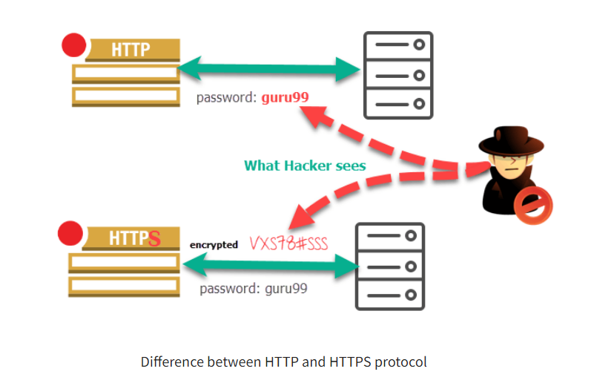
HTTP vs HTTPS
HyperText Transfer Protocol. – Using Port # 80
HyperText Transfer Protocol Secure. Using Port # 443. This uses SSL/TLS connection as a brother.
http website starts with http://
Htttps website starts with https://

Slide 31
What is FTP and SFTP
File Transfer Protocol
users can transfer file (download) or transfer data/files to their computer or the FTP server
SFTP – SSH File Transfer Protocol
SSH is a protocol for secure remote access to a machine over untrusted networks. SSH is a replacement for telnet, rsh, rlogin

